Slide 1
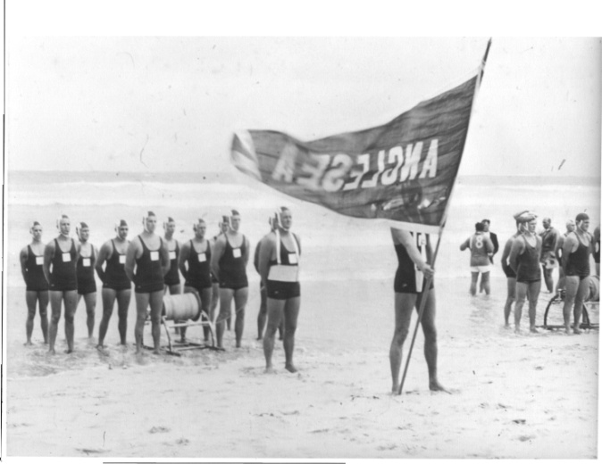
2012 hall of fame
ANGLESEA SLSC INDUCTEES

Slide 2
Hall of Fame Guidelines
Recognising, preserving and honouring:
  athletes/teams
  coaches and
  contributors to the competition program at Anglesea
Sustained excellence and significant accomplishments at club, state, national and international level
Sportsmanship – Integrity – Character
Financial member for at least 7 years
Maximum 5 inductees per year + 1 Legend
Nomination Process

Slide 3
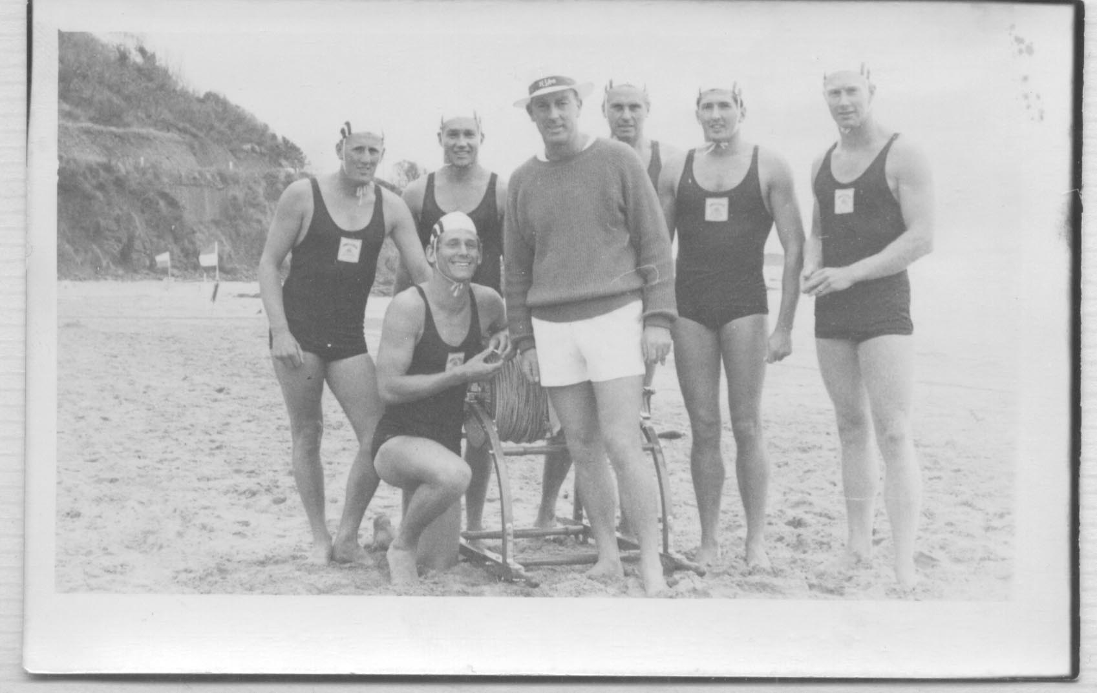
Hall of Fame Inductee
Australian Titles:
Silver Medallists 1963
Bronze Medallists 1964
Victorian Titles:
Gold Medallists 1963
Gold Medallists 1964
Silver Medallists 1965
SENIOR R&r tEAM
Bill Knott - David Kennedy - Robert Kennedy - John Allen Anthony White - Ian Smith - John Worrell (Coach)

Slide 4
Hall of Fame Inductee
Robert King
Australian Team Rep – 1970/71
1 x Gold Medallist – Australian Titles
4 x Silver Medallist – Australian Titles
2 x Bronze Medallist – Australian Titles
12 x Victorian Team Member
21 x Gold Medallist – Victorian Titles
12 x Silver Medallist – Victorian Titles
5 x Bronze Medallist – Victorian Titles
‘bobby’

Slide 5
Hall of Fame Inductee
Stuart fox
2 x Gold Medallist – Australian Titles
2 x Bronze Medallist – Australian Titles
12 x Victorian Team Member
32 x Gold Medallist – Victorian Titles
13 x Silver Medallist – Victorian Titles
8 x Bronze Medallist – Victorian Titles
3 x Margret Worrell Award Recipient
2 x Club Champion
‘foxy’

Slide 6
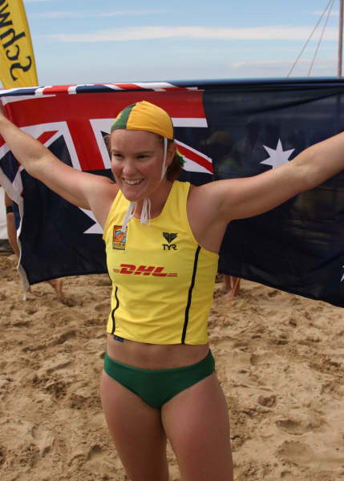
Hall of Fame Inductee
Abby lewtas
Australian Team Member 2006
2 x Gold Medallist – Australian Titles
3 x Silver Medallist – Australian Titles
2 x Bronze Medallist – Australian Titles
9 x Victorian Team Member
2 x Gold Medallist – World Titles
1 x Bronze Medallist – World Titles
29 x Gold Medallist – Victorian Titles
11 x Silver Medallist – Victoria Titles
4 x Bronze Medallist – Victorian Titles
‘Abs’

Slide 7
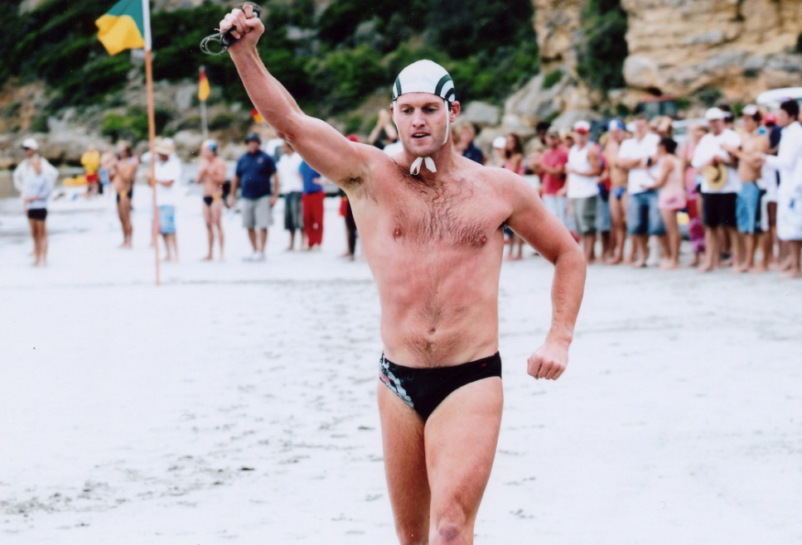
Hall of Fame Inductee
Shane Edmonds
3 x Gold Medallist – Australian Titles
7 x Silver Medallist – Australian Titles
4 x Silver Medallist – Australian Titles
21 x Victorian Team Member
56 x Gold Medallist – Victorian Titles
38 x Silver Medallist – Victorian Titles
30 x Bronze Medallist – Victorian Titles
2 x Margaret Worrell Award Recipient
LSV Awards of Excellence Recipient
6 x Club Champion
‘Edo’

Slide 8
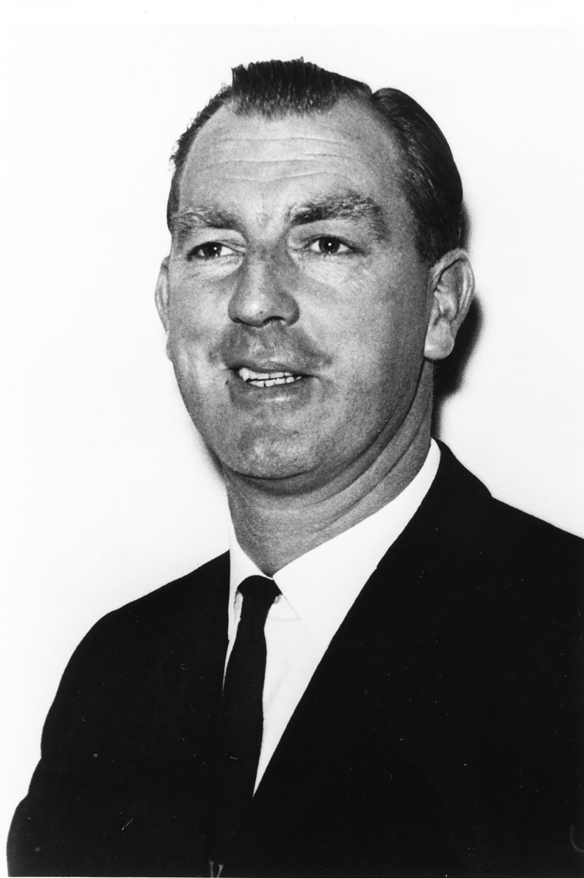
Legend Inductee
John worrell
Coaching/Advisor Years:
1952 – Present
R&R
March Past
Swimming
Surf Belt Racing
SLSV Team Manager
SLSA Team Member
Anglesea Delegate to SLSV Council
SLSA 60-Year Service Award

Slide 9
2012 hall of fame
ANGLESEA SLSC INDUCTEES

