Slide 1
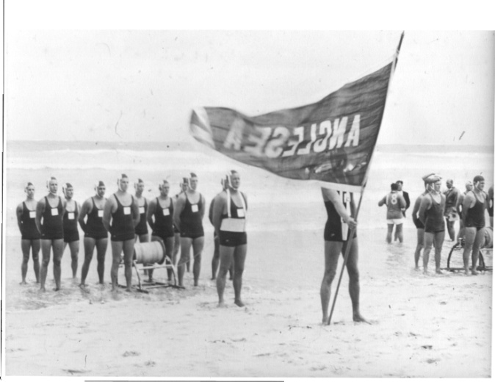
2015 SURF SPORTS hall of fame
ANGLESEA SLSC INDUCTEES
Notes:
Thank you to the Board for allowing this presentation today. A very fitting environment, Anglesea carnival day to highlight Athletes/Coaches of the past whilst a new generation are putting on a show today. I firmly believe recognition in any organisation is a critical foundation component to a successful culture. Even more so in a volunteer organisation.
The Anglesea SLSC Surf Sports Hall of Fame was developed in 2012 in conjunction with the 60th Year celebrations. I would just like to acknowledge the inaugural inductees; Bobby King, Stuart Fox, Shane Edmonds, Abby Lewtas and the Senior R&R Team from the 1960’s
Earlier in the year we called for nominations from the members for a potential new class of inductees.

Slide 2
Hall of Fame Guidelines
Recognising, preserving and honouring:
  athletes/teams
  coaches and
  contributors to the Surf Sports program at Anglesea
Sustained excellence and significant accomplishments at club, state, national and international level
Sportsmanship – Integrity – Character
Financial member for at least 7 years
Maximum 5 inductees per year + 1 Legend
Nomination Process
Notes:
The following criteria were observed when being assessed by the Hall of Fame sub-committee.
[REFER attached content on Slide] – Personality traits.
I would like to thank our resident historian Prue for her dossier of statistics on each inductee. Always very thorough with the detail.
The four inductees were announced at our AGM in August last year, however today is about presenting them in a more formal setting.
It is an honour to present the following inductees to the Anglesea SLSC Surf Sports Hall of Fame.

Slide 3
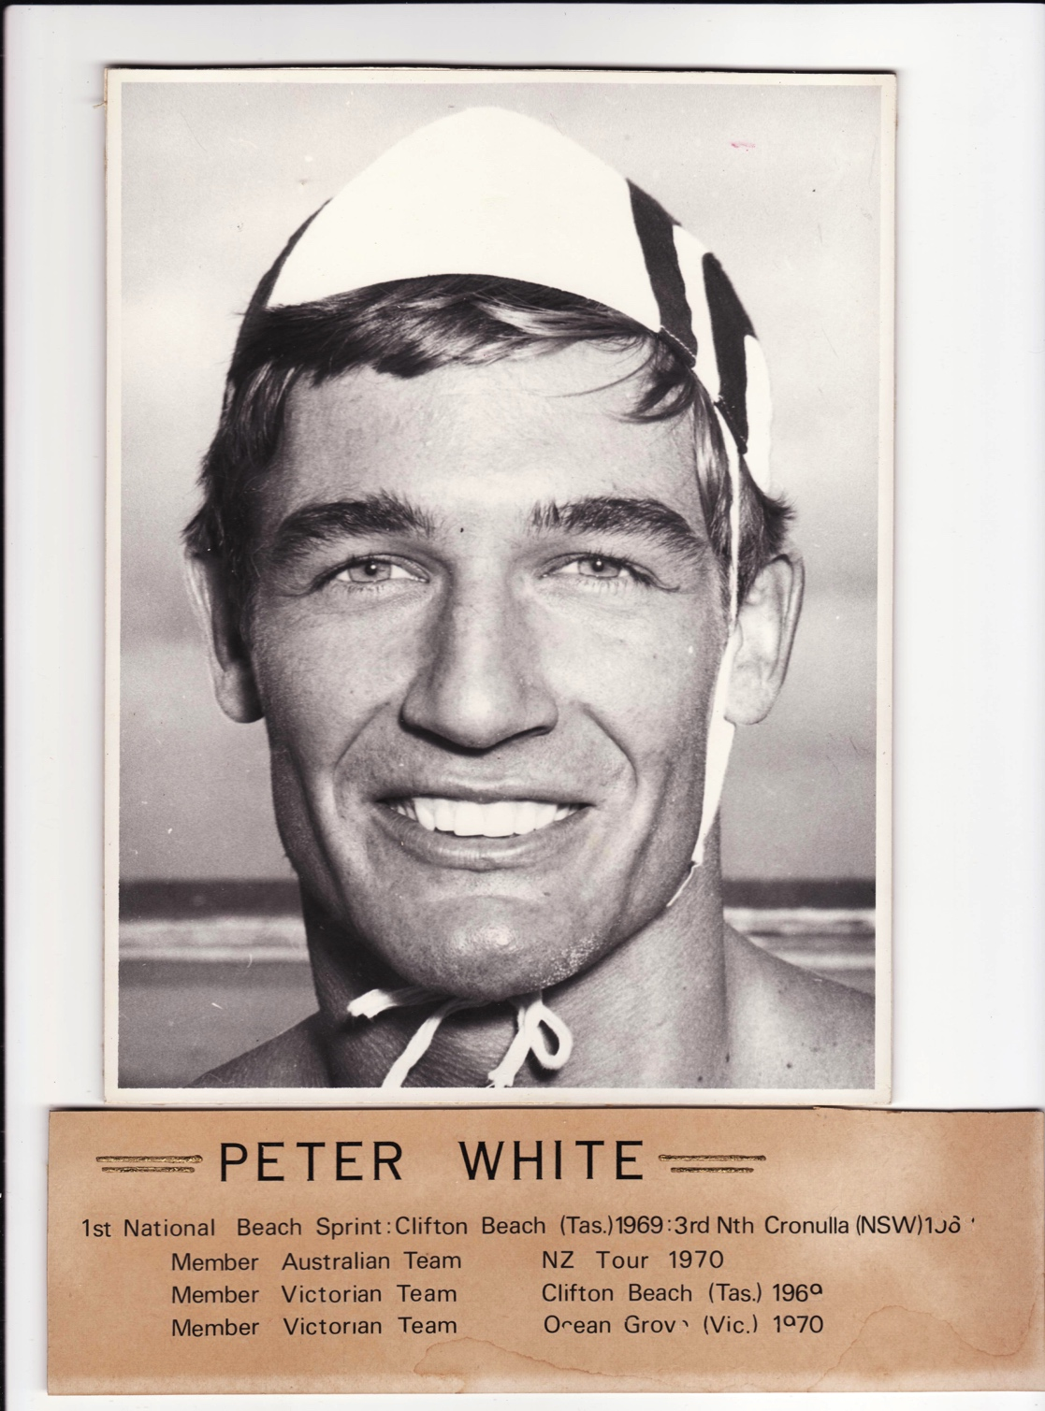
Hall of Fame Inductee
PETER WHITE
1 x Australian Team Selection - 1970
2 x Victorian Team Selection – 1969/70
2 x Silver Medallist – Australian Titles
2 x Bronze Medallist – Australian Titles
7 x Gold Medallist – Victorian Titles
5 x Silver Medallist – Victorian Titles
3 x Junior Club Champion 1963-65
Notes:
Peter White joined Anglesea SLSC in 1962 and was a member until 1982, with an expat stint in the UK in the early 1970’s.
His early surf sports success occurred in the water where he was part of the Junior R&R team that won a Bronze at the Australian Titles in WA in 1965. He was also a multiple Junior Club Champion. Highlighting the versatility as an all round athlete.
Once in the Senior ranks Peter focused primarily on Beach events. You can see by his statistics that it was a good move.
[REFER ATTACHED SLIDE INFORMATION]
Australian Team Selection in 1970 where he won the beach sprint and relay with team mates. Multiple Australian Title and Victorian Title medallist across sprint, beach flag and relay disciplines.
Medals SLSV Titles 1964 R&R Junior 2nd 9
1965 R&R Junior 1st 10
1967,1968, 1976, 1978,1979 Open Beach Relay 1st 50
1967 Open Flags 1st 10
1968 Open Flags 2nd 9
1969 Open Relay 2nd 9
1969, 1970 Open Sprint 2nd 18

Slide 4
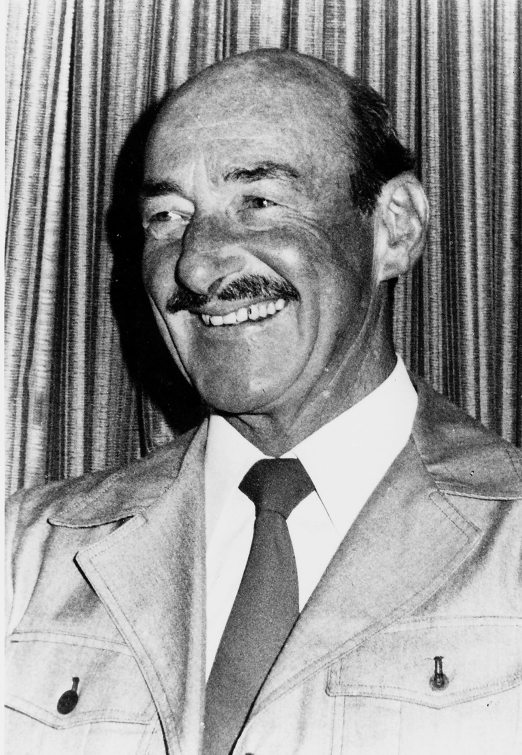
Hall of Fame Inductee
BRUCE THOMPSON
Beach Team Pioneer: 1965-1990
Australian Titles:
4 x Gold Medals
3 x Silver Medals
4 x Bronze Medals
Victorian Titles:
69 x Gold Medals
62 x Silver Medals
64 x Bronze Medals
‘SMOOTHY’
Notes:
Bruce Edward ‘Smoothy’ Thompson joined Anglesea SLSC as an associate in 1960.
Bruce was a Pioneer in establishing a strong beach team culture within the Club.
He oversaw a golden era within the Beach section in his time and was involved with Australian Beach Sprint Gold Medallist such as Bobby King, Paul Congues and Mark Fraser. As well as multiple medals in the relays.
[REFER SLIDE INFORMATION]
Bruce was also instrumental in SLSV selecting a designated beach runner / flagger for State team selection from 1970’s onwards.

Slide 5
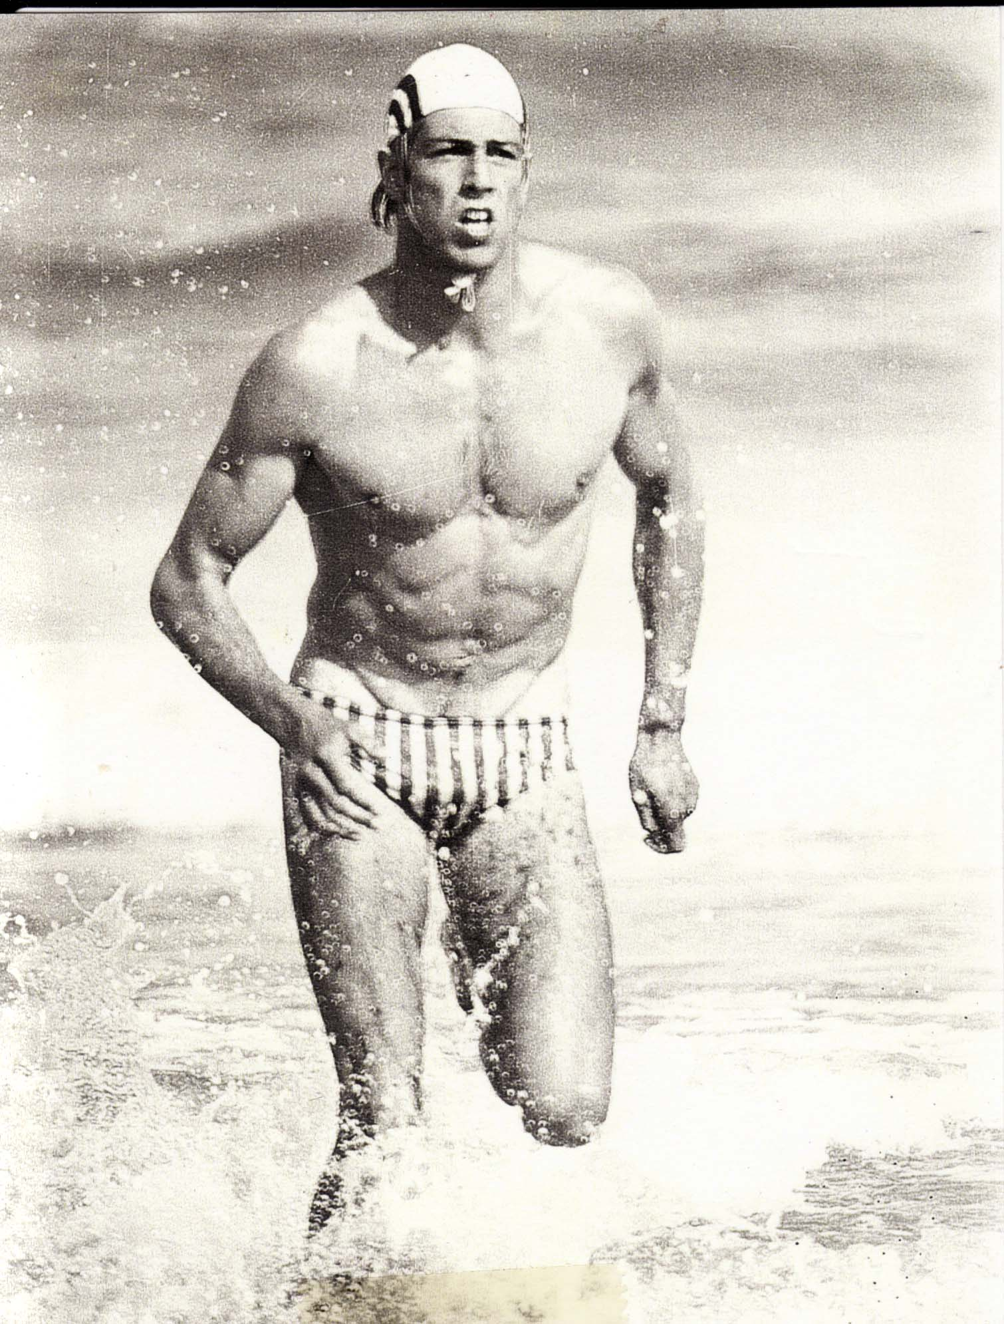
Hall of Fame Inductee
WARREN CLARKE
2 x Australian Team Member – 1979/82
1 x Bronze Medallist – Australian Titles
11 x Victorian Team Member
14 x Gold Medallist – Victorian Titles
8 x Silver Medallist – Victorian Titles
4 x Bronze Medallist – Victorian Titles
Multiple Masters Medallist – Victorian Titles
Athlete/Coach/Administrator/Official
‘CLARKEY’’
Notes:
Warren Peter Clarke joined Anglesea SLSC in the season of 1977/78
REFER SLIDE –
Warren was an elite waterman and aside from his individual success was also instrumental in the success of R&R teams during the late 70’s, early 80’s, 00’s and still today. The majority of his State medals are actually for R&R.

Slide 6
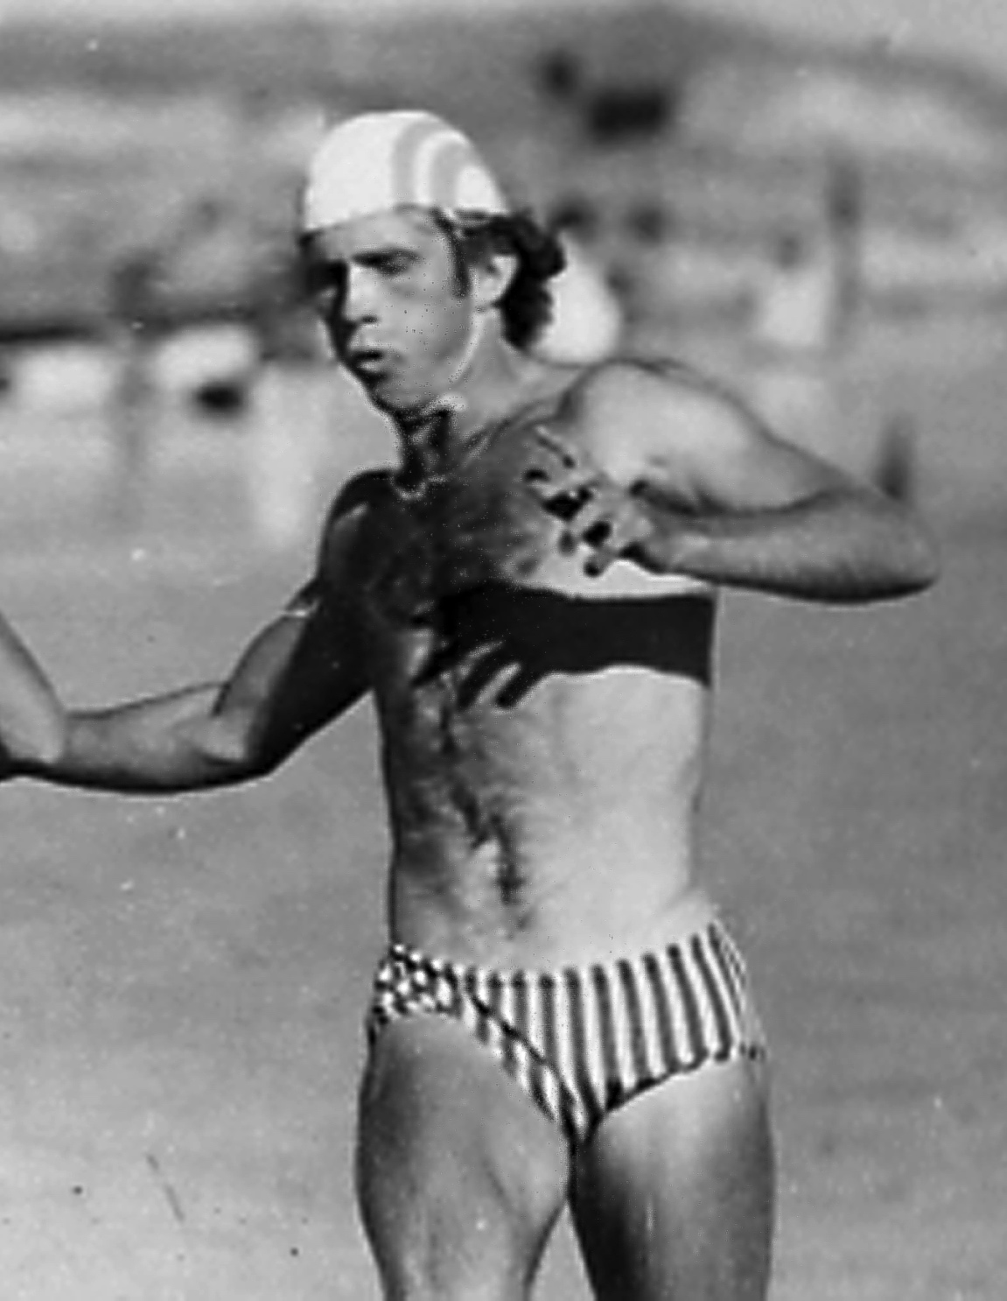
Hall of Fame Inductee
PETER VAN MILTENBURG
Open/Masters Athlete:
5 x Gold Medallist – Australian Titles
3 x Silver Medallist – Australian Titles
2 x Bronze Medallist – Australian Titles
Open/Masters Athlete:
15 x Gold Medallist – Victorian Titles
2 x Silver Medallist – Victorian Titles
1 x Bronze Medallist – Victorian Titles
4 x Victorian Team Member
Notes:
Peter Van Miltenburg joined Anglesea in the 1976/77 season for 3 seasons and then went and focused on his successful Athletics career, where he was a 1984 Olympian.
During that early period he was able to win an Australian Open Beach Sprint Title in 1978, and was also a member of the successful beach relay teams of that era.
[REFER INFORMATION ON SLIDE]
Rejoining the club in 1989, Peter continued competing and then moved into the role as Beach Coach in the early 90’s.

Slide 7
Hall of Fame Inductee
PETER VAN MILTENBURG
Coach:
Open/Masters Results:
24 x Gold Medallist – Australian Titles
16 x Silver Medallist – Australian Titles
22 x Bronze Medallist – Australian Titles
Open/Masters Athlete:
237 x Gold Medallist – Victorian Titles
142 x Silver Medallist – Victorian Titles
138 x Bronze Medallist – Victorian Titles
LSV Coach of the Year – 3 times
Federation Sports Award 2001
Notes:
His coaching record is phenomenal across age groups, gender and disciplines (flags, sprints and relays).
[REFER SLIDE INFORMATION]
His strength from a coaching perspective was his communication with his athletes in a clear and concise way and the technical aspects of each discipline.
At the Australian titles we did not always have the four fastest athletes, however the achievements in beach relays were a testament to the focus on making sure we were technically the best.

Slide 8
2015 hall of fame
ANGLESEA SLSC INDUCTEES

