Slide 1
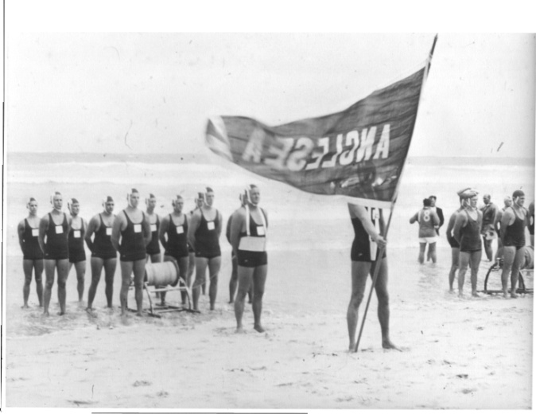
2019 SURF SPORTS hall of fame
ANGLESEA SLSC INDUCTEES
Notes:
Hello, for those that don’t know me I am Matthew Symington Chair of the Surf Sports Hall of Fame advisory committee.
Thank you to the Board for allowing this presentation today. A very fitting environment, Anglesea carnival day to highlight Surf Sports Athletes(teams)/Coaches/Contributors of the past whilst a new generation are creating their own history. I firmly believe recognition in any organisation is a critical foundation to a successful culture. Even more so in a volunteer organisation.
The Anglesea SLSC Surf Sports Hall of Fame was developed in 2012 in conjunction with the 60th Year celebrations. I would just like to acknowledge the inaugural inductees; Bobby King, Stuart Fox, Shane Edmonds, Abby Lewtas, the 1960’s Senior R&R Team and our Legend John Worrell. The second cohort in 2015 of Peter Van Miltenburg, Warren Clarke, Peter White and Bruce ‘Smoothy’ Thompson.
Late last year we called for nominations from the members for a new class of inductees.

Slide 2
Hall of Fame Guidelines
Recognising, preserving and honouring:
  athletes/teams
  coaches and
  contributors to the Surf Sports program at Anglesea
Sustained excellence and significant accomplishments at club, state, national and international level
Sportsmanship – Integrity – Character
Financial member for at least 7 years
Maximum 5 inductees per year + 1 Legend
Nomination Process
Notes:
The following criteria were observed when being assessed by the Hall of Fame advisory committee.
[REFER attached content on Slide] – Personality traits.
I would like to thank those that nominated and the members of the advisory committee.
I would also like to thank our resident historian Prue for her dossier of statistics on each inductee. Always very thorough with the detail.
Today we have three inductees, it is an honour to present the following inductees to the Anglesea SLSC Surf Sports Hall of Fame.

Slide 3
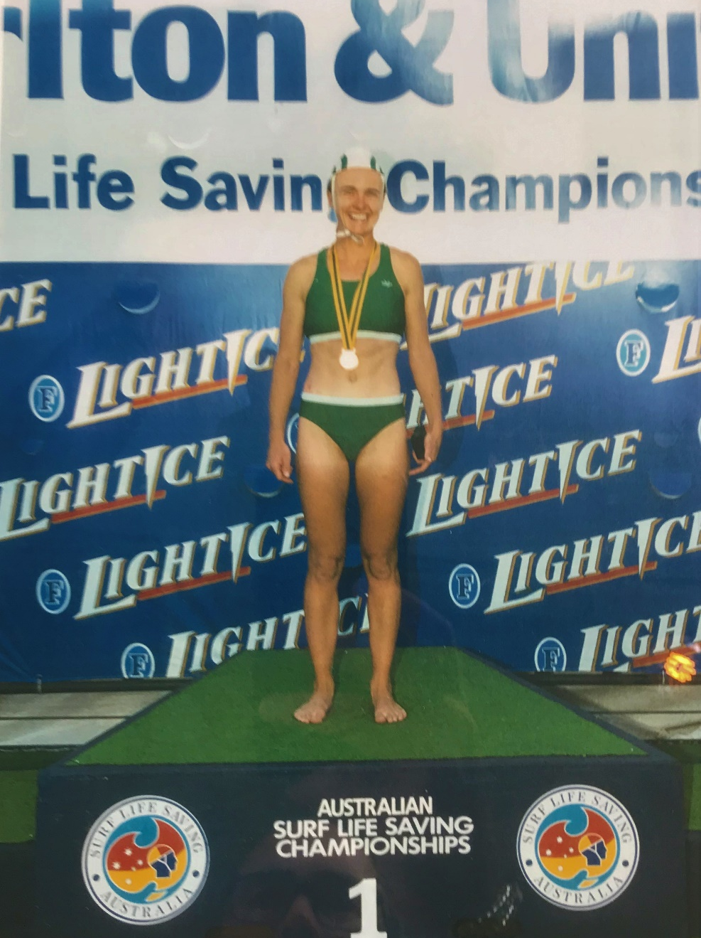
Hall of Fame Inductee
3 x Gold Medallist – Australian Titles
Bronze Medallist – Australian Titles
Gold Medallist – World Titles 2006
2 x Bronze Medallist – World Titles
2 x Victorian Team Selection – 1999/00
Vanessa Jacobs
Notes:
Vanessa Jacobs (nee Guest) joined Anglesea SLSC in 1995, after completing her BM at Pt.Leo in 1993.
Vanessa was a fierce competitor both on the training track and in competition. She was an integral part of and competed through the halcyon days of the Anglesea beach team circa 1995-2005.
You can see by her CV of achievements that Vanessa was a dominant force in Female beach events for a sustained period at State, National and World Titles in both Open and Masters. Making Open Australian Flag finals multiple years in a row. The pinnacle of her career being an epic battle with her team mate (Elly Hutton) on the beach at Kurrawa in 1999 to secure a famous Australian Title.
[REFER ATTACHED SLIDE INFORMATION]
SLSV Surf League Team Selection 1999
SLSV Co Team manager 2000/01
Placings ASLC Rescue 2006 Team 2006
1st Womens 90+ Beach Relay 2005/06
3rd Womens Beach Relay Open
3rd Womens Taplin Relay Open
Placings Senior SLSA Titles for ASLSC
3rd Womens Beach Relay Open 1996/97
1st Womens Beach Flags Open 1998/99
1st Womens 30+ Beach Sprint 2004/05
1st Womens 30+ Beach Flags 2004/05
Placings Senior SLSV Titles for ASLSC
1st Womens Beach Flags Open 1995/96; 1997/98; 1998/99, 1999/2000;
1st Womens Beach Sprint Open 1995/96
1st Womens Beach Relay Open 1995/96; 1996/97; 1998/99; 2004/05
2nd Womens Beach Flags Open 1996/97; 2004/05
2nd Womens Beach Sprint Open 1996/97; 1998/99
2nd Womens Beach Relay Open 19999/2000
3rd Womens Beach Sprint Open 1998/99
Placing Masters SLSV Titles for Anglesea SLSC
1st Womens 30+ Beach Sprint 2004/05; 2005/06
1st Womens 30+ Beach Flags 2004/05; 2005/06
1st Womens 140+ Beach Relay 2004/05; 2005/06
ASLSC Awards
Bruce Thompson 1998/99; joint 2005/06
Special Achievement 1998/99; 1999/2000; 2004/05; 2005/06
Best Patrol 2000/01
Other Awards
Australian Federal Government Sports Award 2000/01

Slide 4
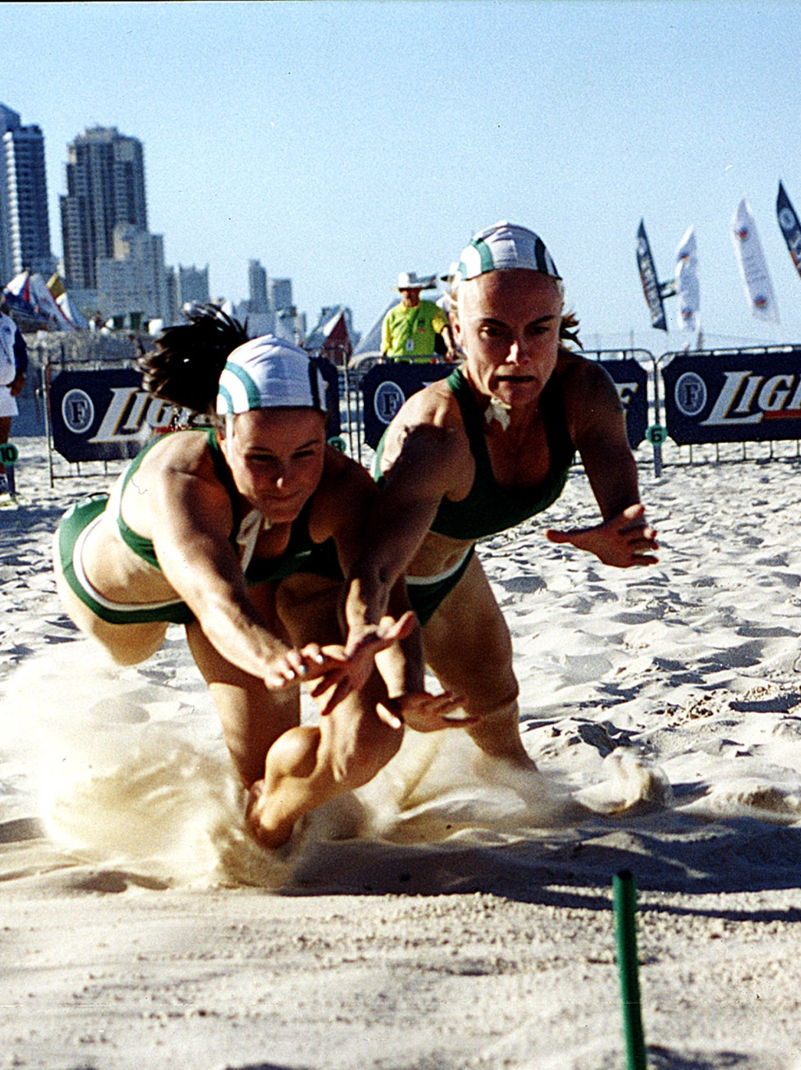
Hall of Fame Inductee
15 x Gold Medallist – Victorian Titles
5 x Silver Medallist – Victorian Titles
1 x Bronze Medallist – Victorian Titles
2 x Bruce Thompson award recipient
Australian Sports Award 2000
Vanessa Jacobs
Notes:
Vanessa was also a 4 time Victorian Open Women’s beach flag champion and re-defined some of the training techniques used to turn straight and keep low. All key components of a great flagger.
[REFER ATTACHED SLIDE INFORMATION]
SLSV Surf League Team Selection 1999
SLSV Co Team manager 2000/01
Placings ASLC Rescue 2006 Team 2006
1st Womens 90+ Beach Relay 2005/06
3rd Womens Beach Relay Open
3rd Womens Taplin Relay Open
Placings Senior SLSA Titles for ASLSC
3rd Womens Beach Relay Open 1996/97
1st Womens Beach Flags Open 1998/99
1st Womens 30+ Beach Sprint 2004/05
1st Womens 30+ Beach Flags 2004/05
Placings Senior SLSV Titles for ASLSC
1st Womens Beach Flags Open 1995/96; 1997/98; 1998/99, 1999/2000;
1st Womens Beach Sprint Open 1995/96
1st Womens Beach Relay Open 1995/96; 1996/97; 1998/99; 2004/05
2nd Womens Beach Flags Open 1996/97; 2004/05
2nd Womens Beach Sprint Open 1996/97; 1998/99
2nd Womens Beach Relay Open 19999/2000
3rd Womens Beach Sprint Open 1998/99
Placing Masters SLSV Titles for Anglesea SLSC
1st Womens 30+ Beach Sprint 2004/05; 2005/06
1st Womens 30+ Beach Flags 2004/05; 2005/06
1st Womens 140+ Beach Relay 2004/05; 2005/06
ASLSC Awards
Bruce Thompson 1998/99; joint 2005/06
Special Achievement 1998/99; 1999/2000; 2004/05; 2005/06
Best Patrol 2000/01
Other Awards
Australian Federal Government Sports Award 2000/01

Slide 5
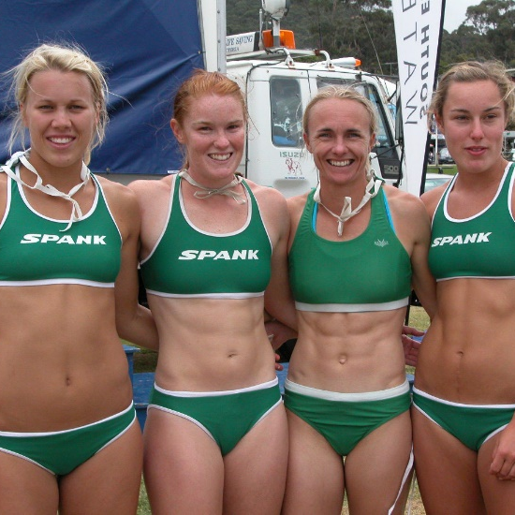
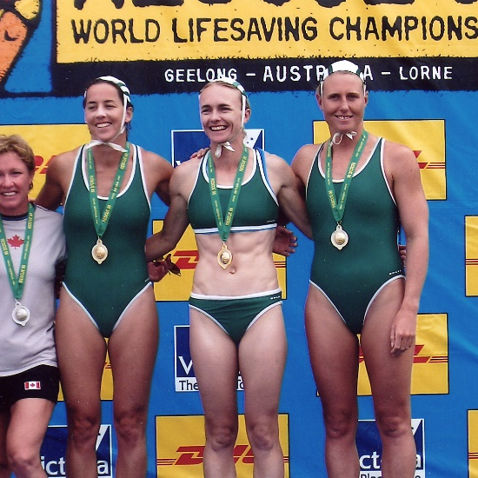
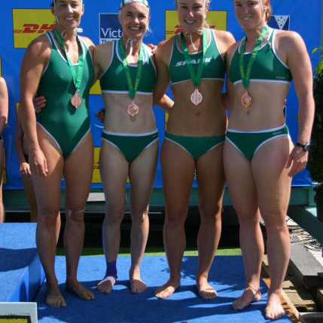
HALL OF FAME INDUCTEE
VANESSA JACOBS

Slide 6
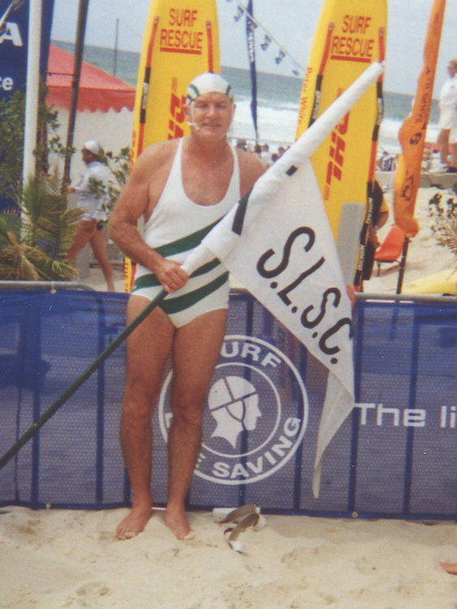
Hall of Fame Inductee
jOHn baldock
3 x Victorian Team Selection – 72/73/76
Silver Medallist – Australian Titles ‘70
6 x Gold Medallist – Victorian Titles
4 x Silver Medallist – Victorian Titles
Bronze Medallist – World Titles
20+ years as a Coach for the Anglesea Beach Team
‘SMOOTHY’
Notes:
John ‘Balls’ Baldock joined Anglesea SLSC in1965 and has been representing the club and the Surf Sports area (beach) in some capacity since then. If you do the maths approximately 54-years. A commitment like that is considered outstanding and worthy, even before we mention his achievements.
John was part of the pioneering days of the Anglesea Beach team in the late 60’s and thru the 70’s and was a ‘bull’ in the flags area with 2 Open Victorian Titles and multiple Open Beach relay titles.
However, I know he would say his greatest achievement and thrill in Surf Lifesaving would be his role as a coach, mentor and friend to the next wave of beachies which spans 20+ years and still continues today. He along with his partner in coaching Peter Van Miltenburg have been instrumental in developing not only great athletes who have achieved multiple world, Australian and State medals but great human beings as well.
The person who nominated John put it this way, ‘John is more than an outstanding coach and competitor. He is a person of excellent character, always ready to help, mentor and encourage fellow members. John is an example of a truly dedicated surf lifesaver, has made an invaluable contribution to the club and surf sports and deserves recognition by induction into the Anglesea SLSC Surf Sports Hall of Fame.
[REFER SLIDE INFORMATION]

Slide 7
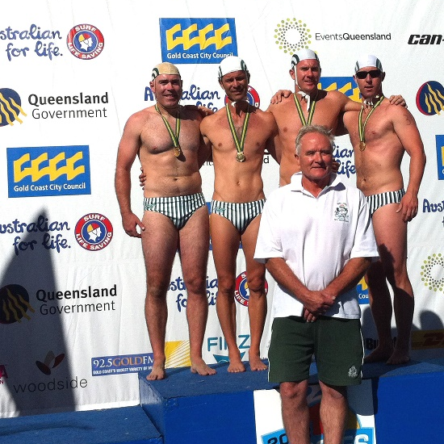
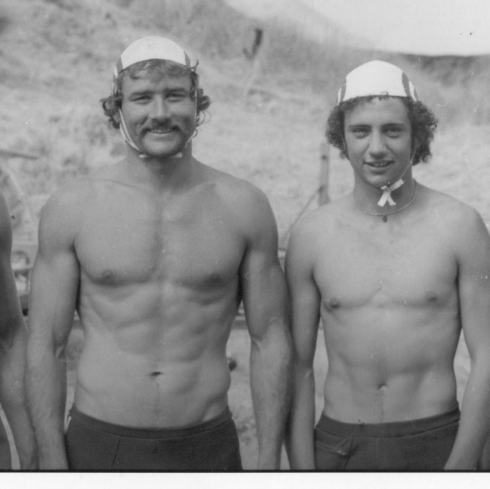
Hall of fame inductee
JOHN ‘BALLS’ BALDOCK

Slide 8
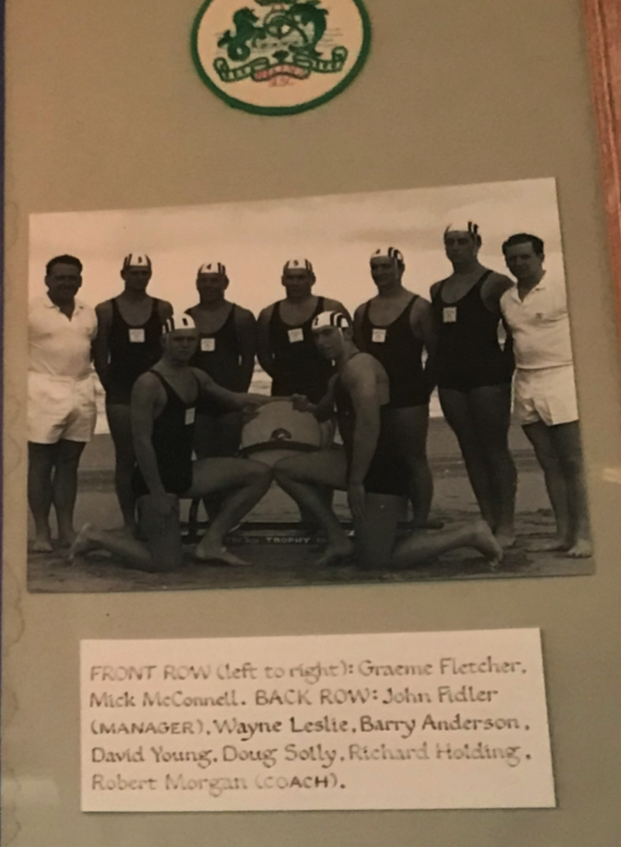
Hall of Fame Inductee
Junior r&R Team
Gold Medallist – Australian Titles 1966
Bronze Medallist – Australian Titles 1965
2 x Gold Medallists – Victorian Titles
Notes:
R&R has been a mainstay of the Anglesea Surf Sports team since the club inception in 1952. Obviously with all clubs, sections go through periods of sustained success and on the flip side, barely enough members to make a team.
However, the 60’s were a strong period for the Anglesea R&R team, with the influence of technical coaches such as John Worrell and Robert Morgan, Anglesea was fortunate to secure Australian Titles in both senior and junior teams during the decade. With the Senior R&R team as inaugural inductees into the Hall of Fame in 2012, we now welcome the Junior R&R team.
The team consisting of Grahame Fletcher, Mick McConnell, Wayne Leslie, Barry Anderson, David Young, Doug Solly and Richard Holding. Coached by Robert Morgan and managed by John Fidler captured the 1966 Australian Title at Coolangatta. With the majority of the team backing up from their Bronze medal in 1965, this team was nearly unbeatable over the summers of 1965 and 1966, including two Victorian titles.
I would like to acknowledge that not all members of the team are represented today or unfortunately are no longer with us, however we do have Mick McConnell, Doug Solly, David Young and Richard Holding and I would ask that come to the stage to receive their plaques.

Slide 9
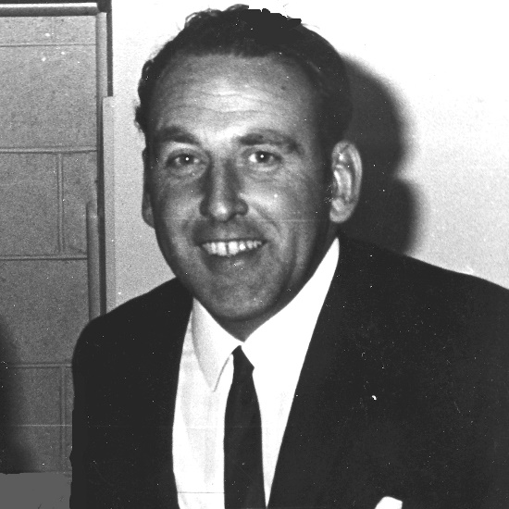
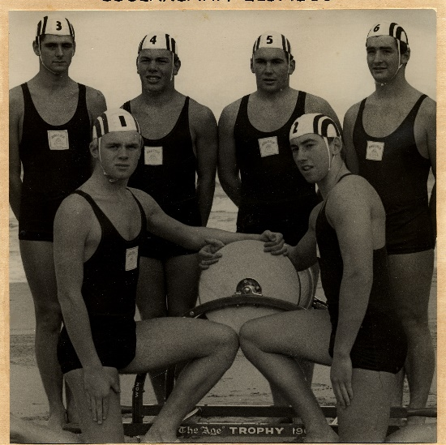
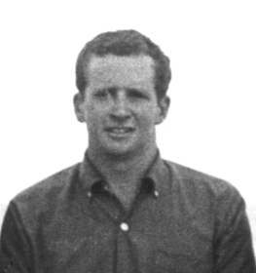
HALL OF FAME INDUCTEE
JUNIOR R&R TEAM – Wayne Lesley, Barry Anderson, David Young, Doug Solly, Grahame Fletcher, Mick McConnell, Richard Holding – Coach Robert Morgan and Manager John Fidler

Slide 10
2019 hall of fame
ANGLESEA SLSC INDUCTEES

